Slide 1
WIPRO NGA Program – DWS BATCH 4
Capstone Project Presentation
Presented by
- Sowmeeka Sivanantham

Slide 2
Task 1 Patch an MSI with New Version or Updated Files. Create and apply MSP (patch) files to an existing MSI installation

Slide 3
OBJECTIVE:
Capture 7-Zip setup.exe
Convert it into MSI packages
Update MSI from version 23.01 to 25.01 using MSP patch.
Automate installation and uninstallation processes using PSADT.

Slide 4
TOOLS & ENVIRONMENTS:
Tools:
Advanced Installer :Used for creating MSI/MSP
Repack.exe :Used for Capturing the Installation
PSADT:PSADT scripts used for automation of installation and uninstallation

Slide 5
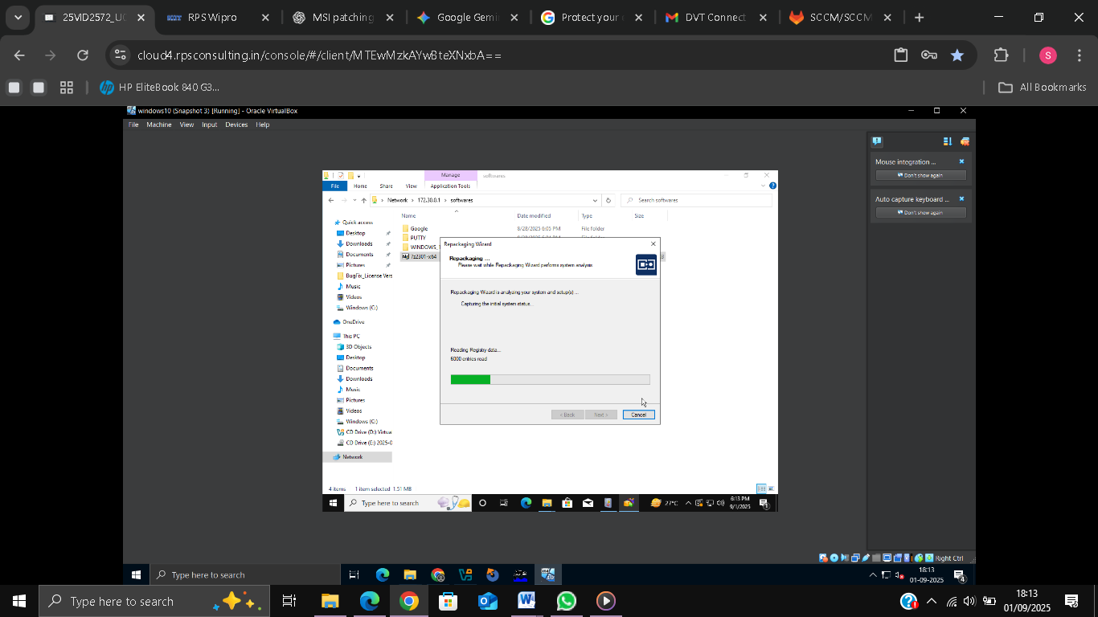
REPACKAGING AND CAPTURING
Downloaded 7-Zip setup.exe and copied to VM.
Ran Repack.exe to capture installation (multi snapshots).
Generated IRP file with installation changes.

Slide 6
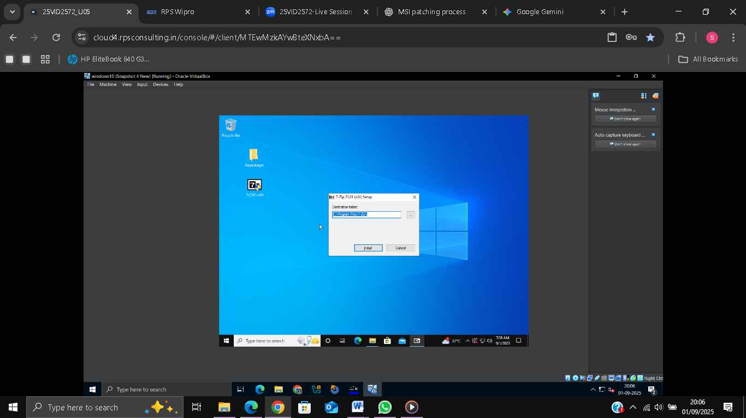
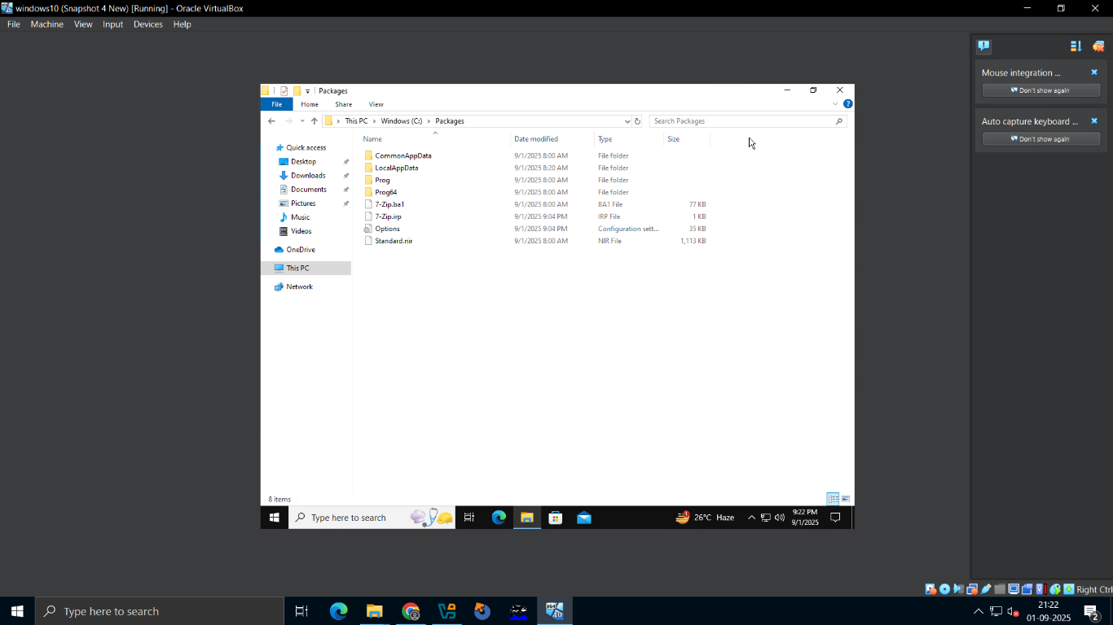
REPACKAGING AND CAPTURING
Capturing installation of 7-Zip using Repack.exe

Slide 7
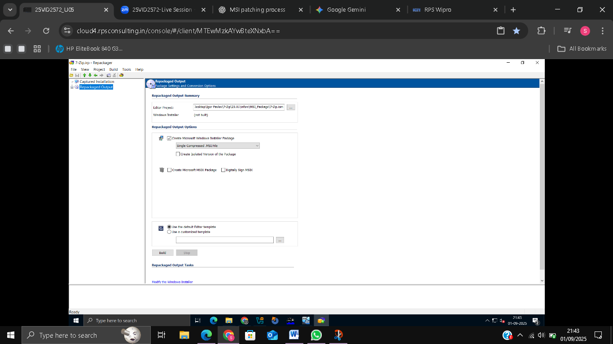
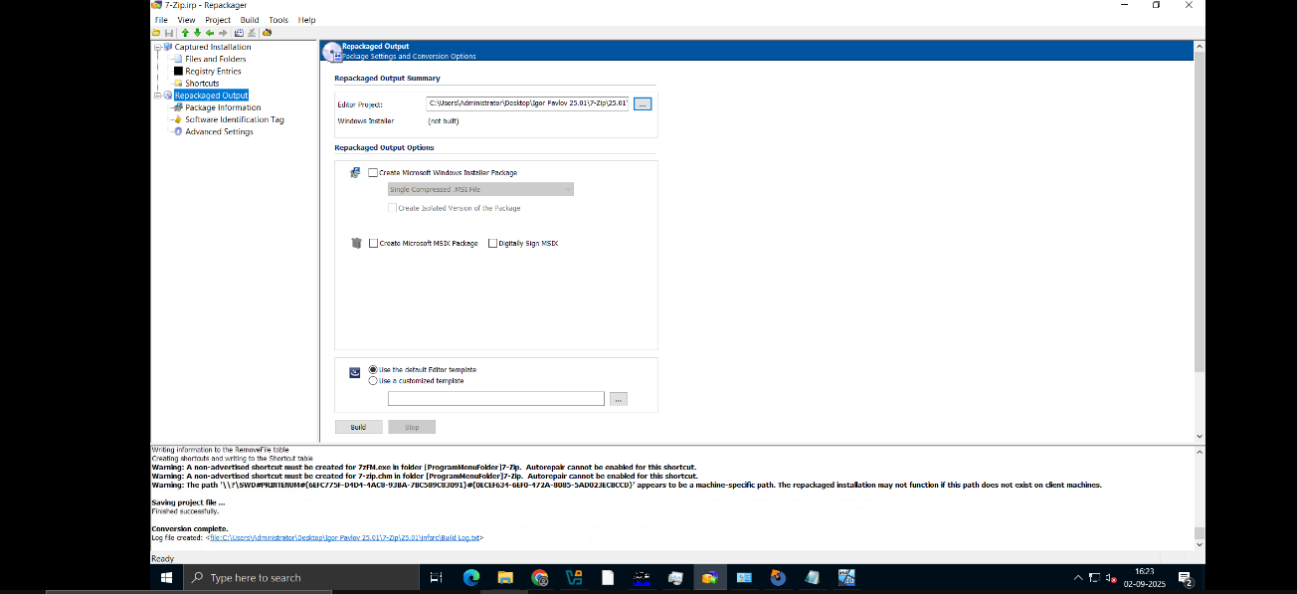
EDITING IRP & CREATING ISM FILE
Removed unnecessary files from IRP.
Created ISM project file from cleaned IRP.
Prepared ISM for MSI build.

Slide 8
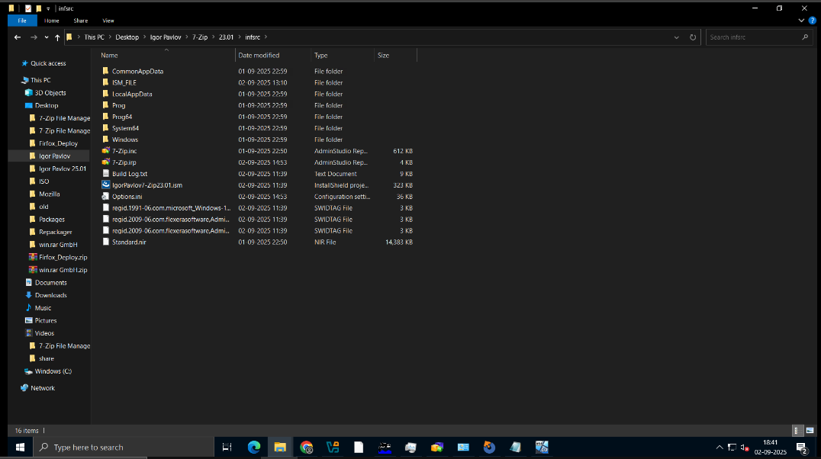
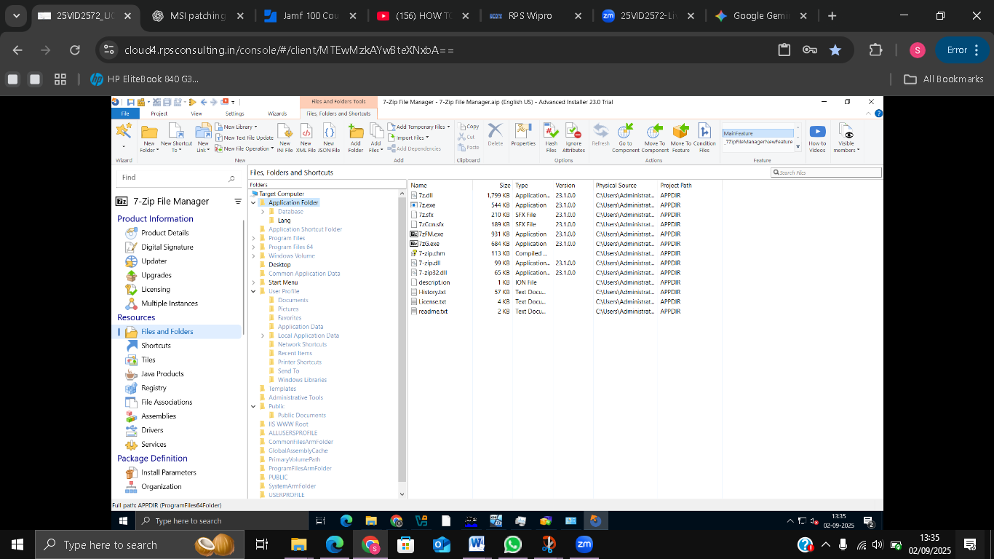
CREATING MSI FILE
Built MSI v23.01 from ISM project.
Updated version → built MSI v25.01.
Verified installation functionality.

Slide 9
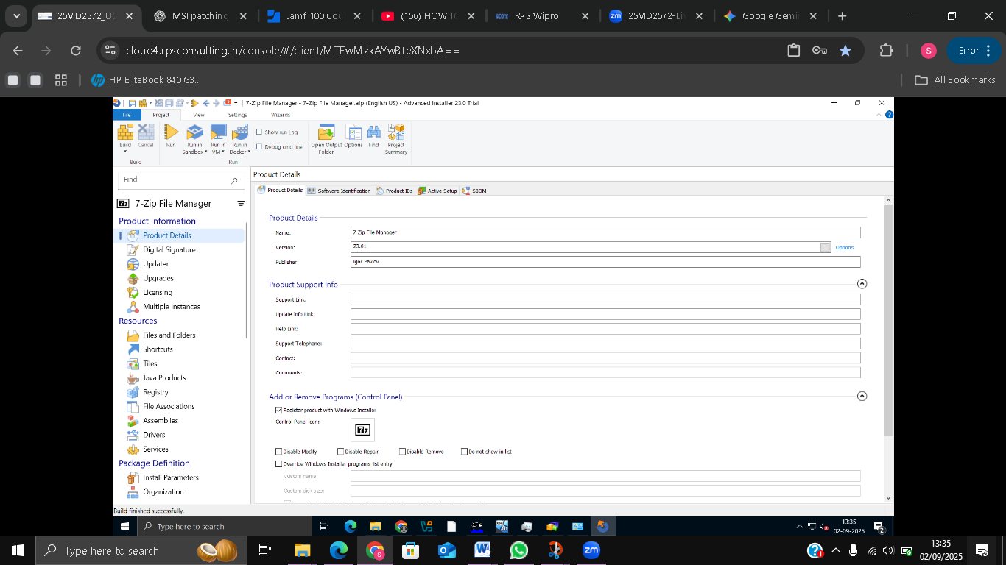
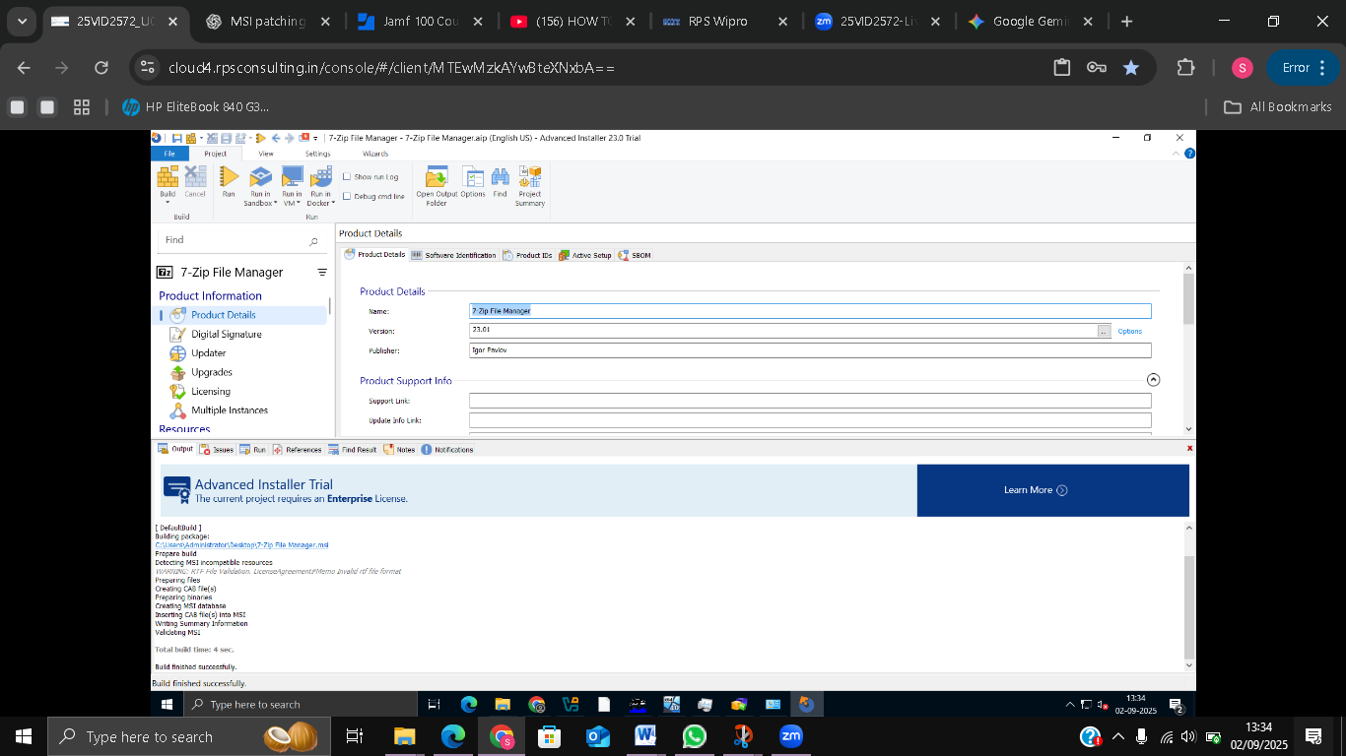
CREATING MSI FILE

Slide 10
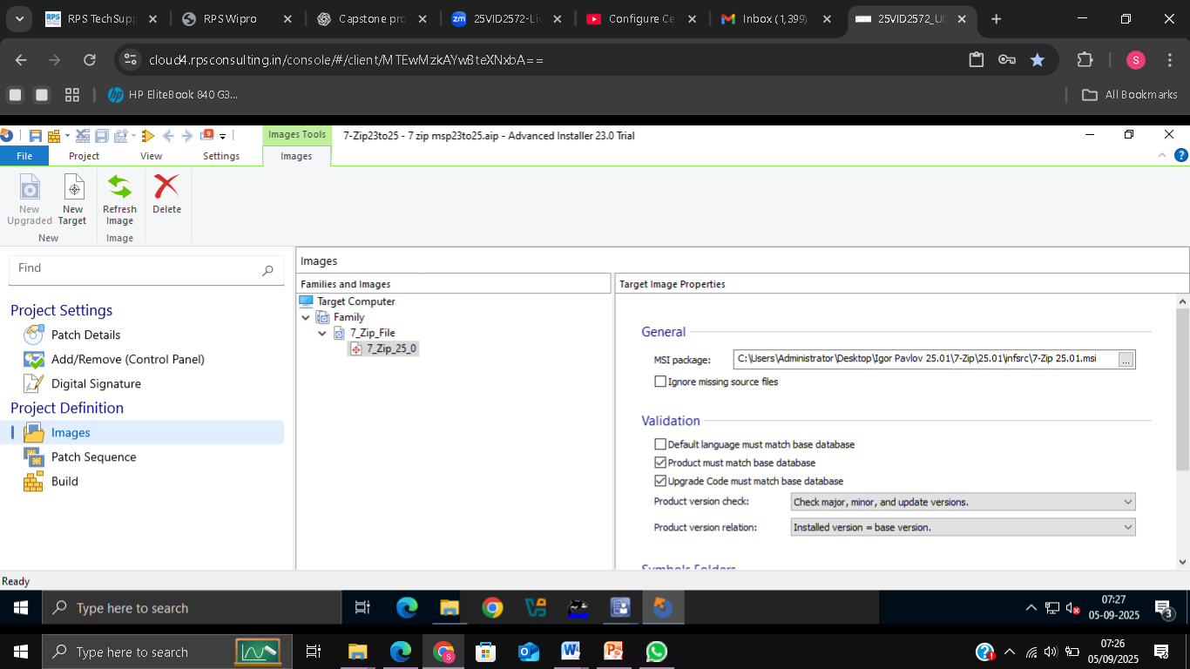
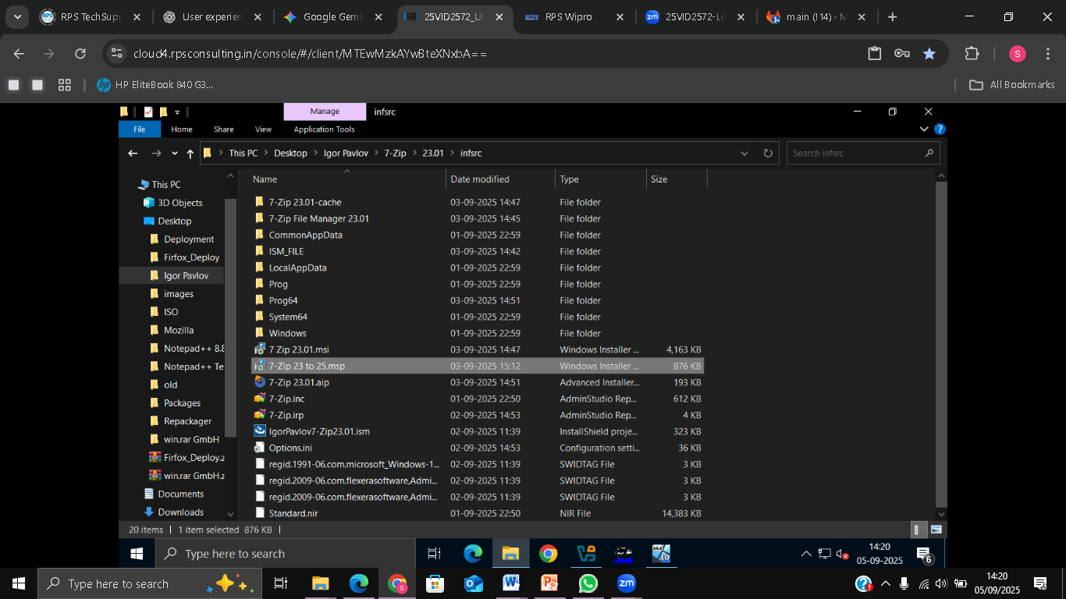
CREATING MSP PATCH FILE
Created MSP patch: target MSI v23 → upgraded to v25.
Tested patch locally to ensure successful upgrade.
Patch avoids uninstalling older version.

Slide 11
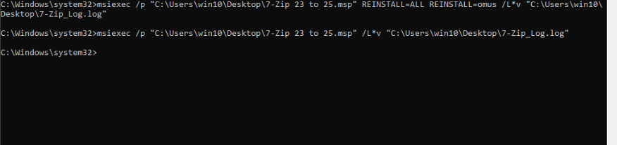
INSTALLATION VIA COMMAND PROMPT
Installed MSI v23.01 using Command Prompt.
Applied MSP patch to upgrade to v25.01.
Verified installation and uninstallation successfully.

Slide 12
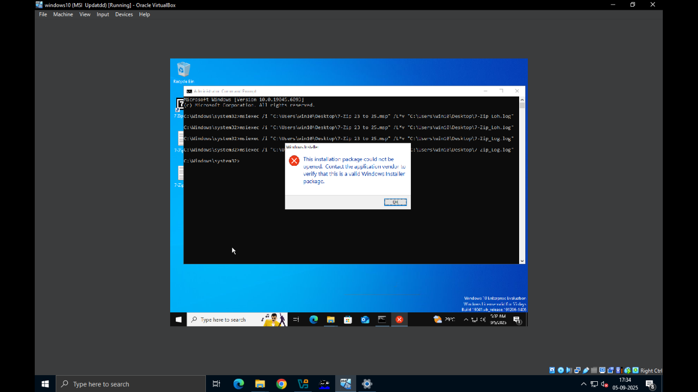
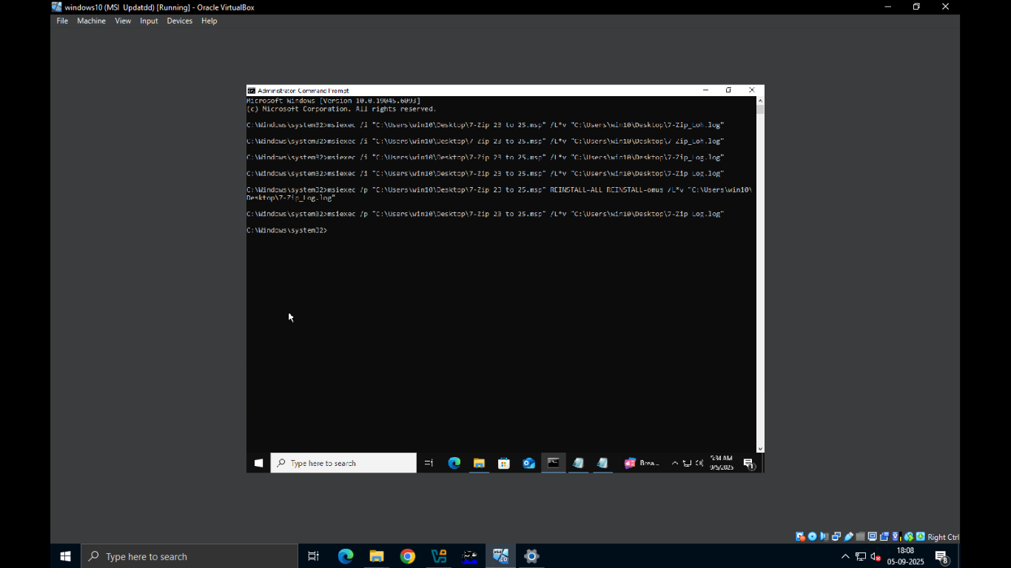
Got error while installing MSP → corrected command → patch installed successfully

Slide 13
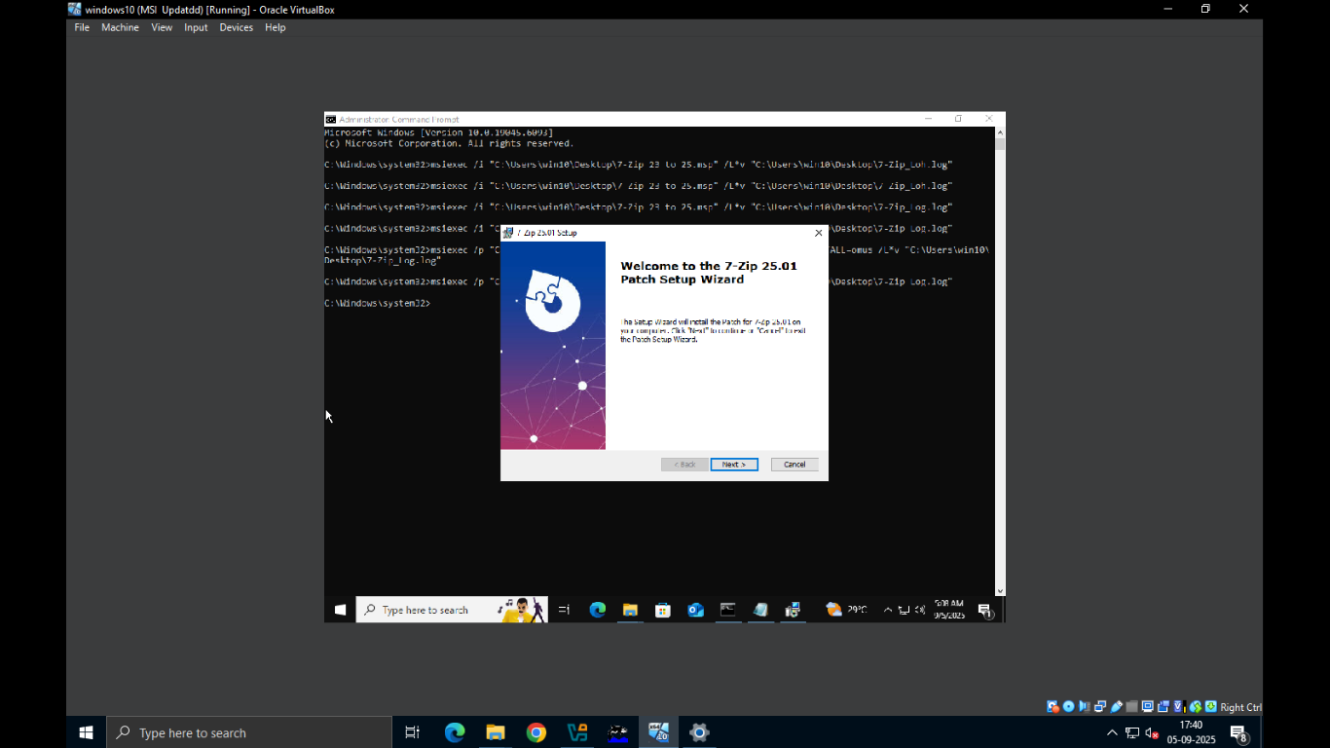
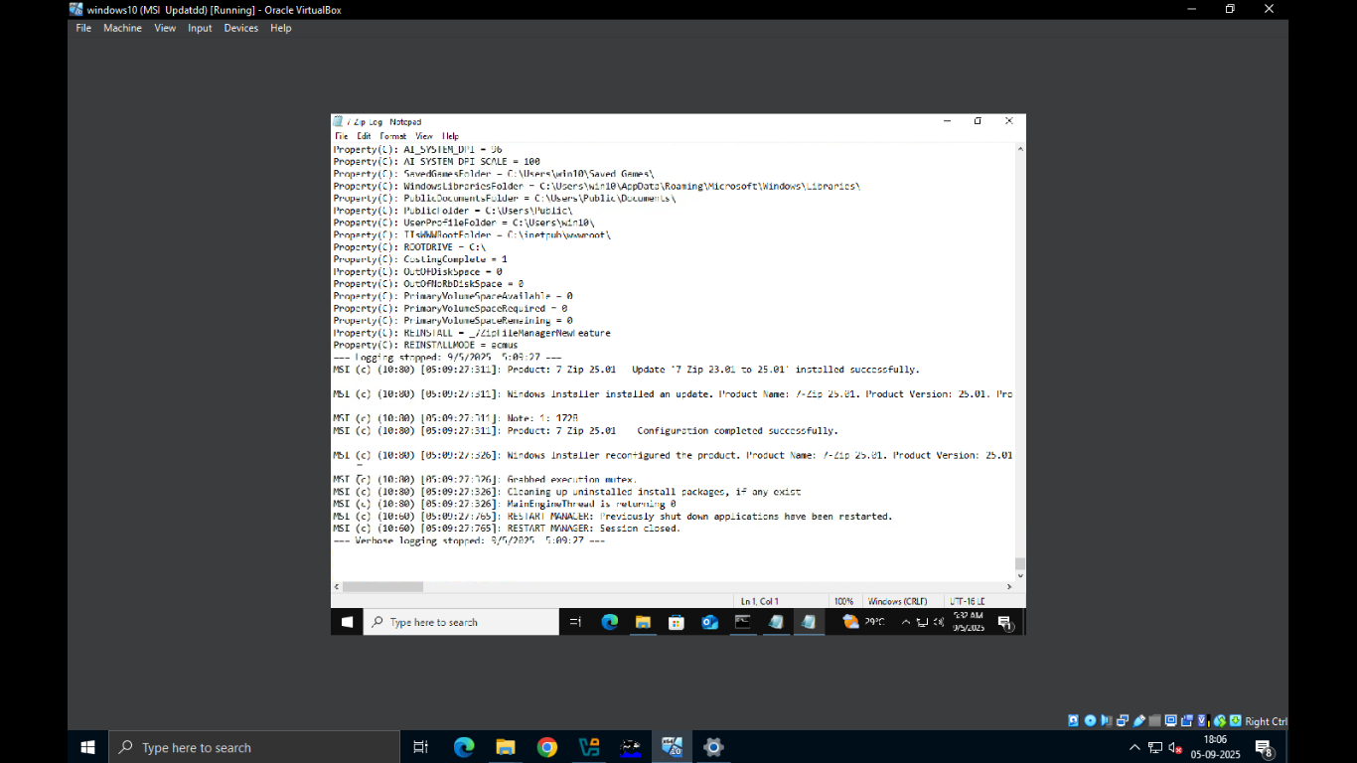
7-Zip installation started and created log file successfully

Slide 14
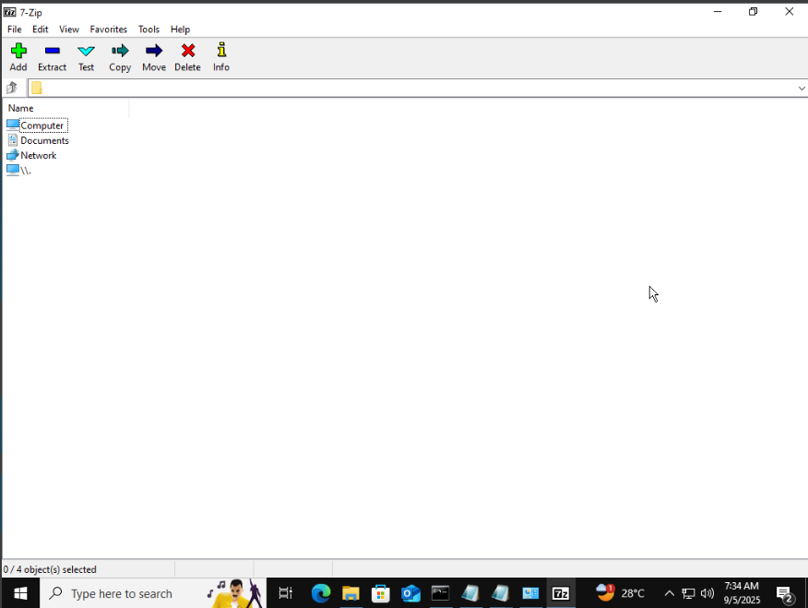
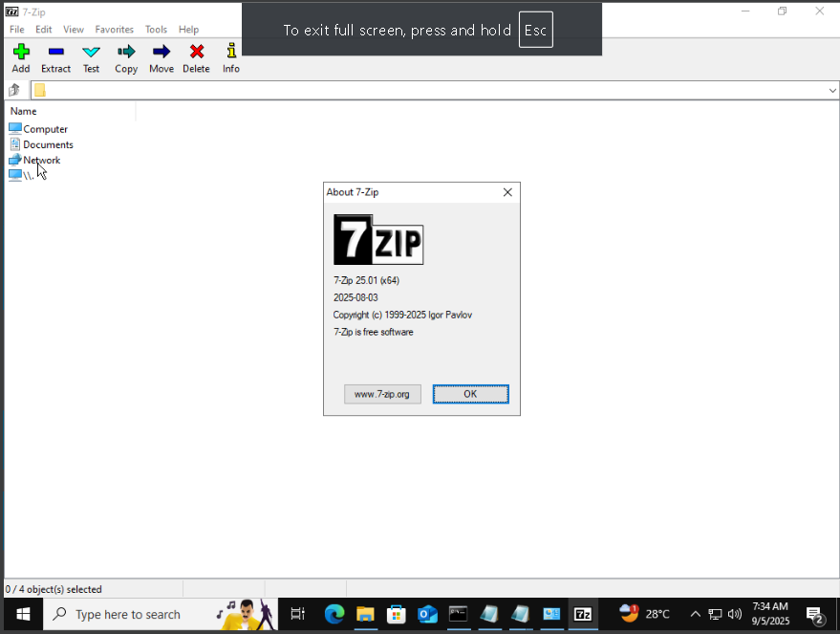
7-Zip application launched – verifying upgrade to version 25.01

Slide 15
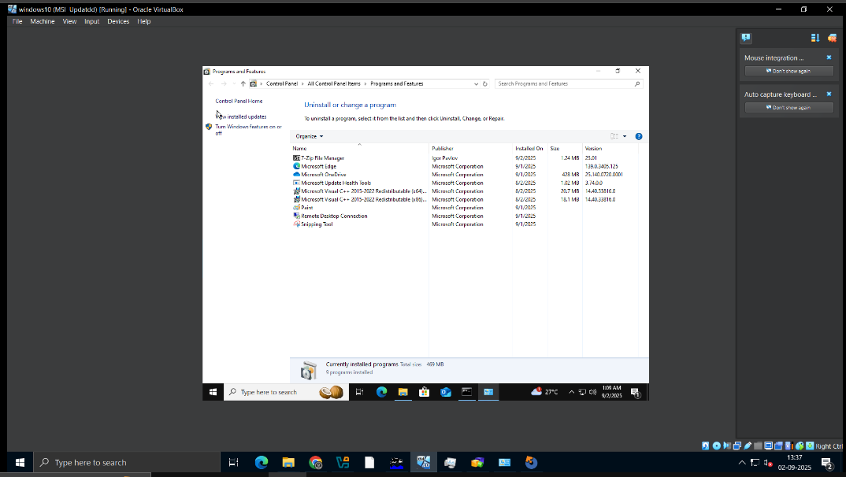
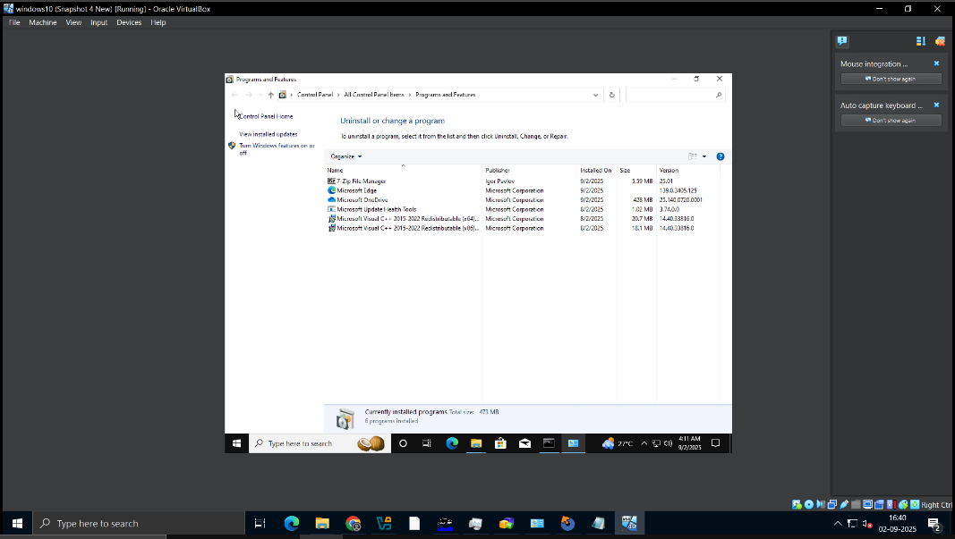
Before: 7-Zip version 23.01 installed
After: 7-Zip version 25.01 after applying MSP patch

Slide 16
INSTALLATION & UNINSTALLATION VIA PSADT
Added MSI and MSP files to PSADT deployment folder.
Wrote install/uninstall scripts with descriptive comments.
Automated deployment worked correctly.
COMMANDS:
Install: .\Invoke-AppDeployToolkit.exe -DeploymentType Install
Uninstall: .\Invoke-AppDeployToolkit.exe-DeploymentType Uninstall

Slide 17
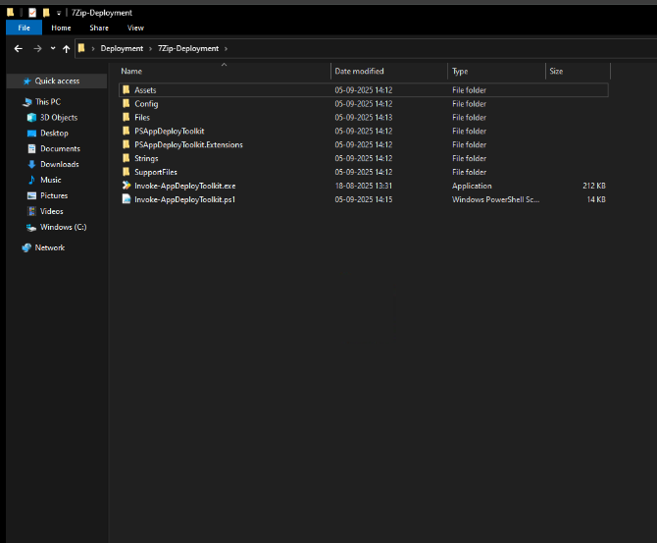
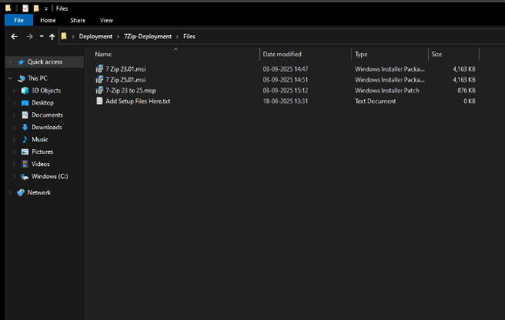
7-Zip PSADT deployment folder

Slide 18
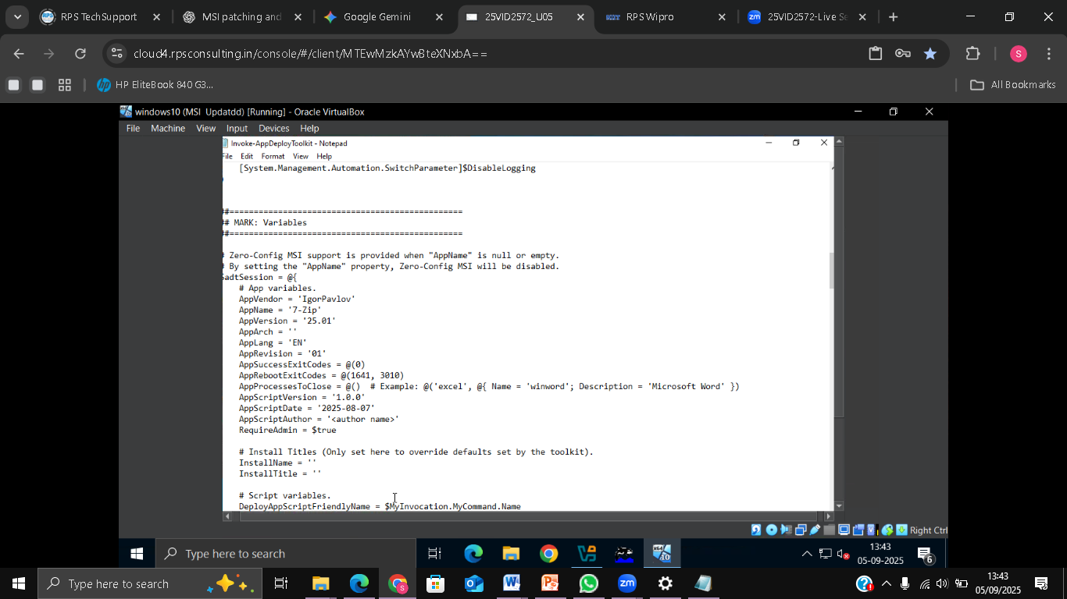
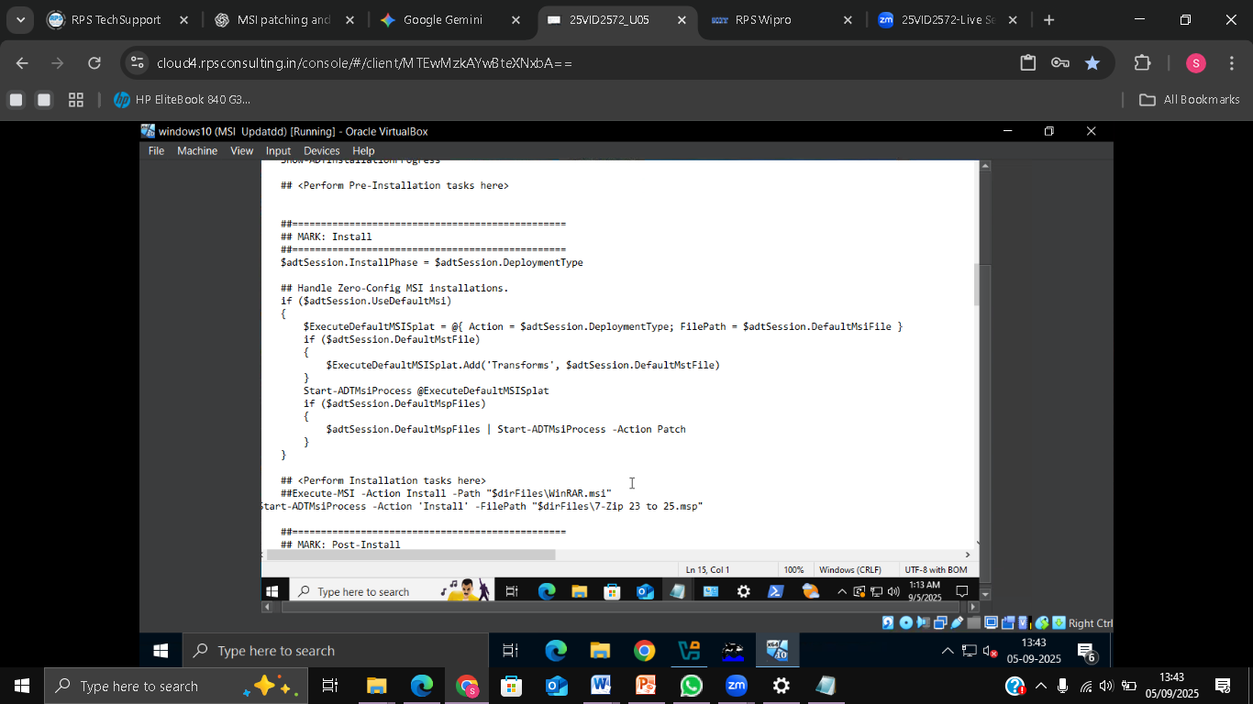

Slide 19
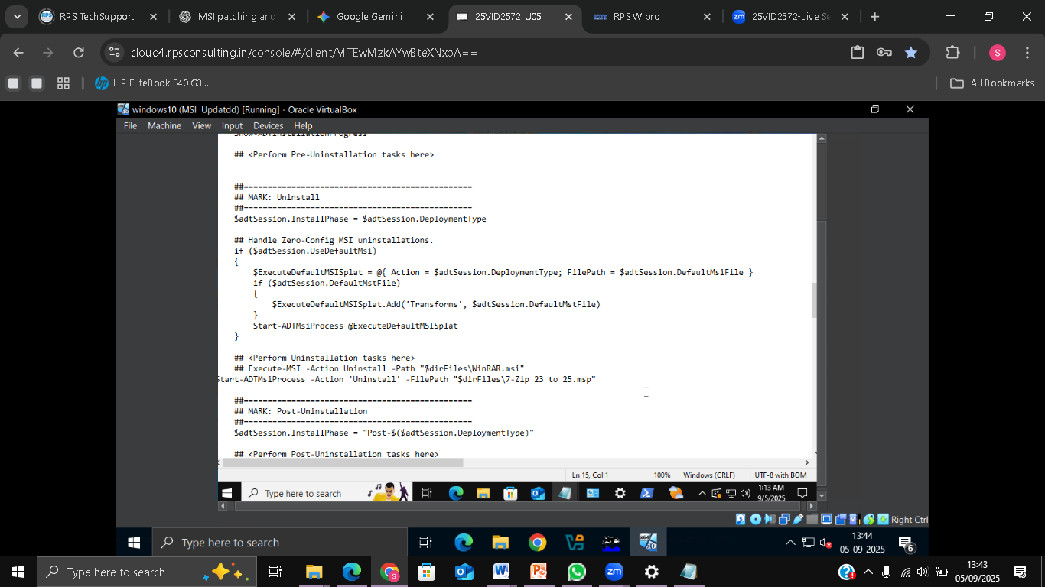
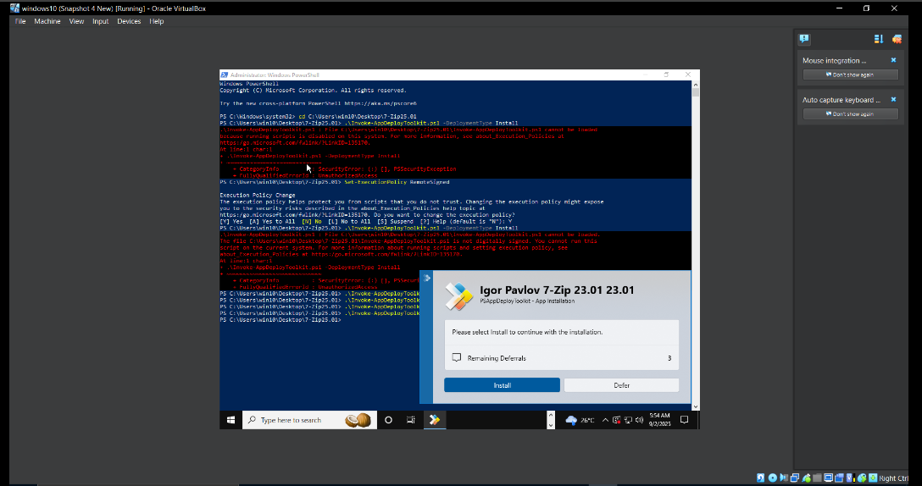
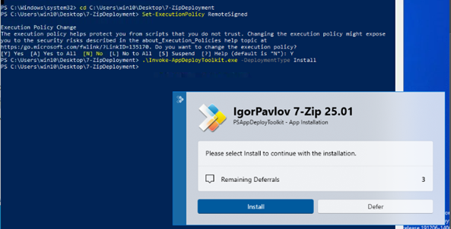
Error encountered while running PS1 script
Resolved by setting Execution Policy

Slide 20
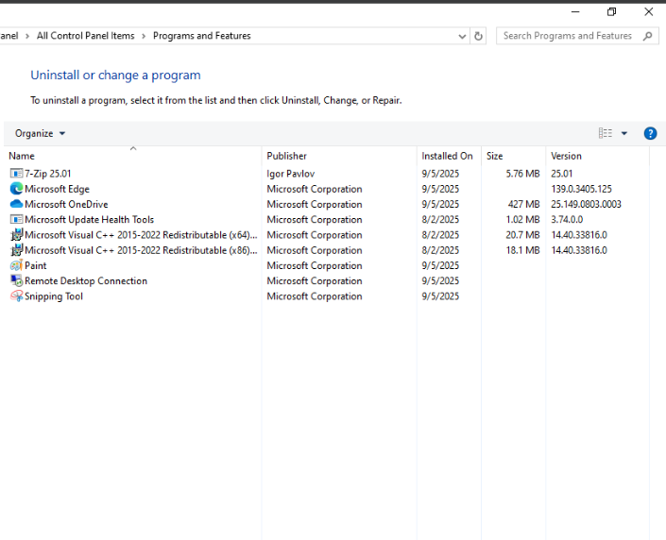
PSADT script executed – application installed successfully

Slide 21
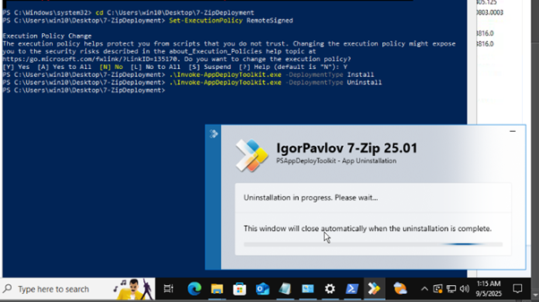
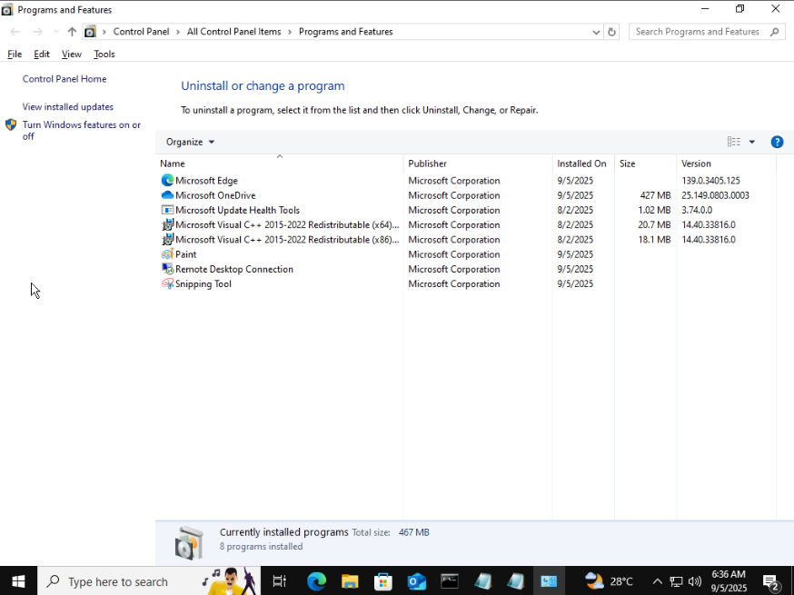
PSADT script executed – application uninstalled successfully

Slide 22
Task 2 Create MSIX with Setup.exe Capture a setup.exe to create msix package

Slide 23
OBJECTIVE:
Capture setup.exe of Notepad++
Convert captured installer into MSIX package
Sign MSIX package with certificate
Prepare for deployment via PSADT
Deploy MSIX package on VM for testing
Verify installation and Uninstallation

Slide 24
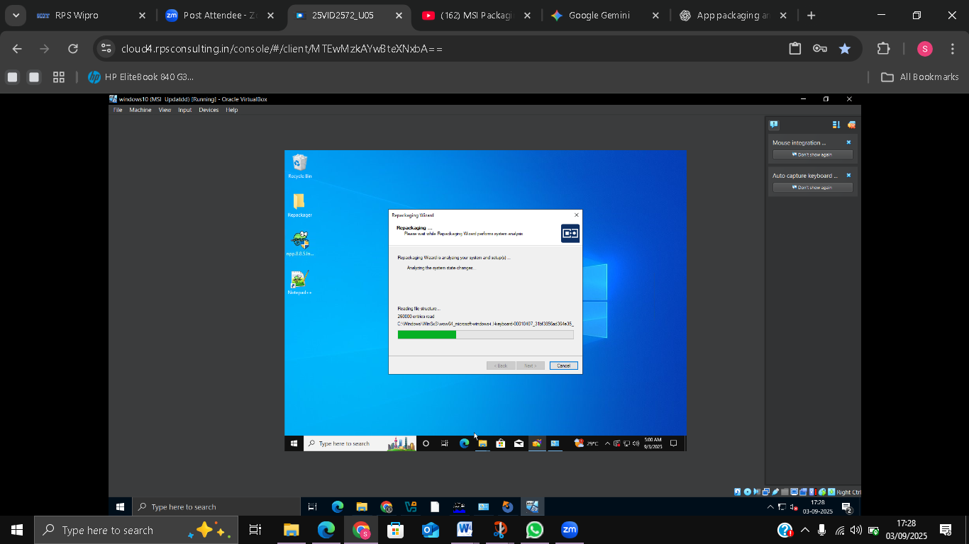
REPACKAGING AND CAPTURING
Downloaded Notepad++ setup.exe v8.8.5.
Launched Repack.exe tool on VM.
Ran installer while capturing process.
Generated IRP file containing installation changes.

Slide 25
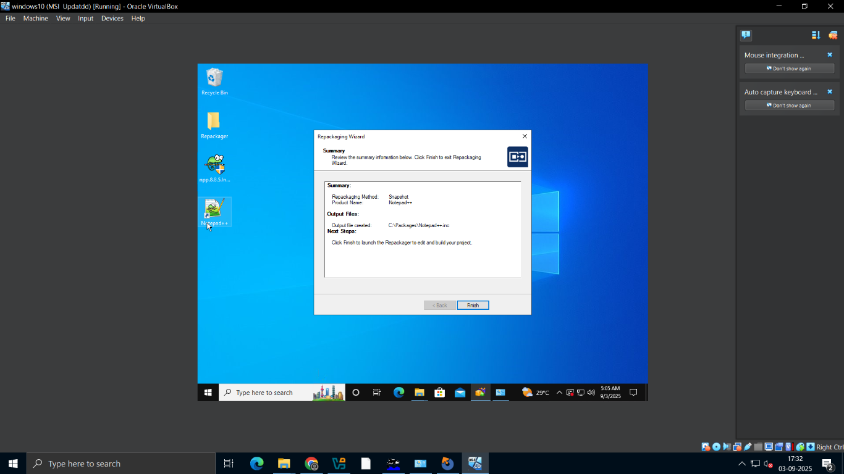
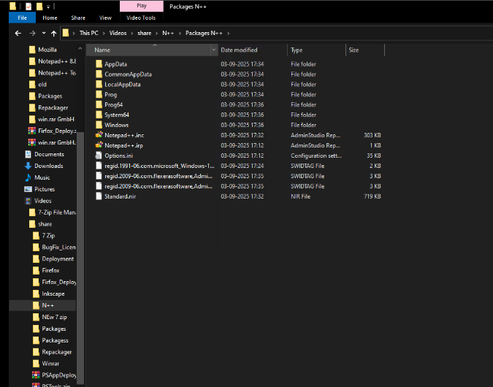
Capturing the Installation and Generating the IRP

Slide 26
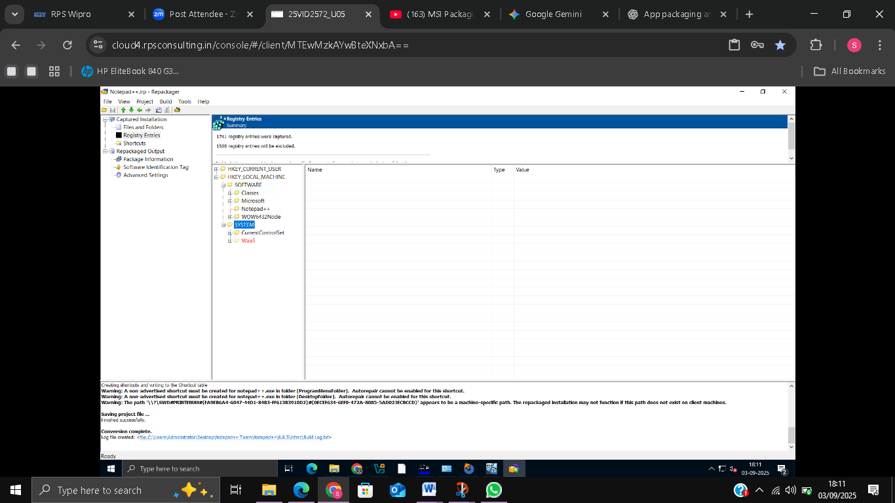
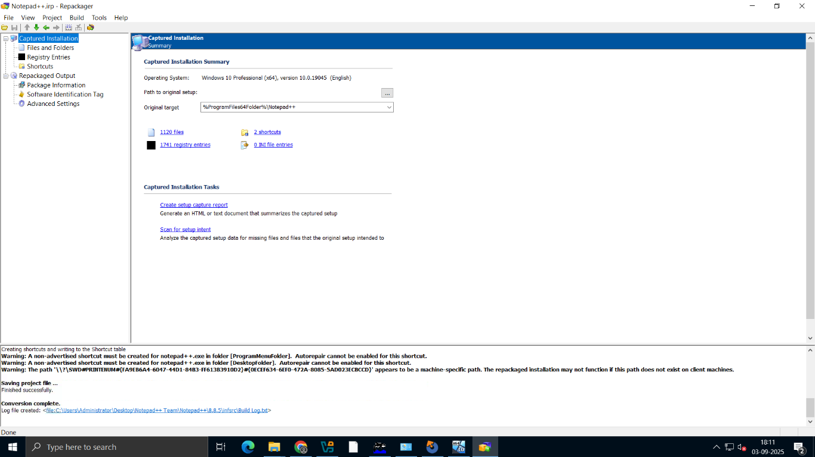
EDITING IRP & CREATING ISM FILE
Removed unnecessary files from IRP.
Created ISM project file from cleaned IRP.
Created ISM for MSI build.

Slide 27
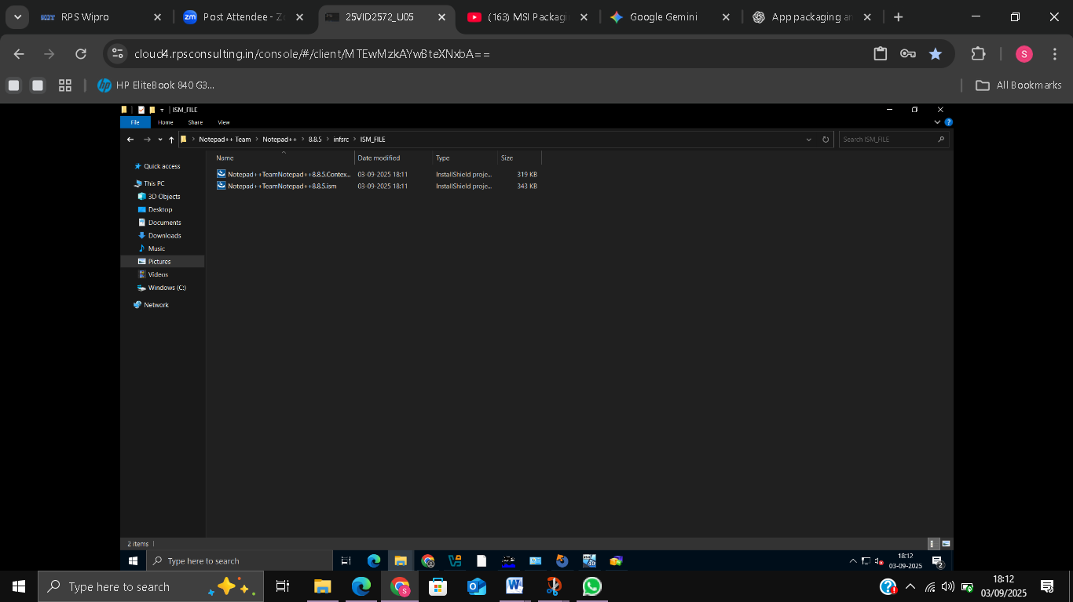
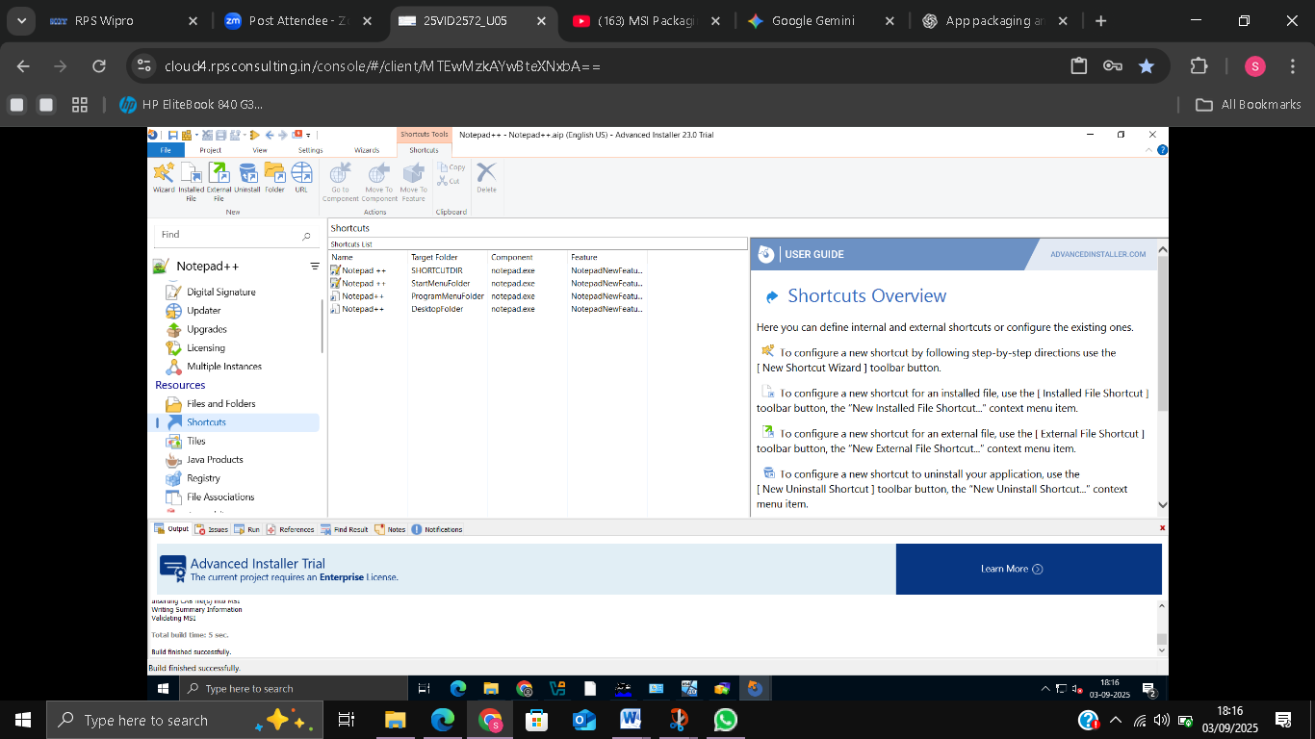
CREATING MSI FILE
Built MSI from ISM project.

Slide 28
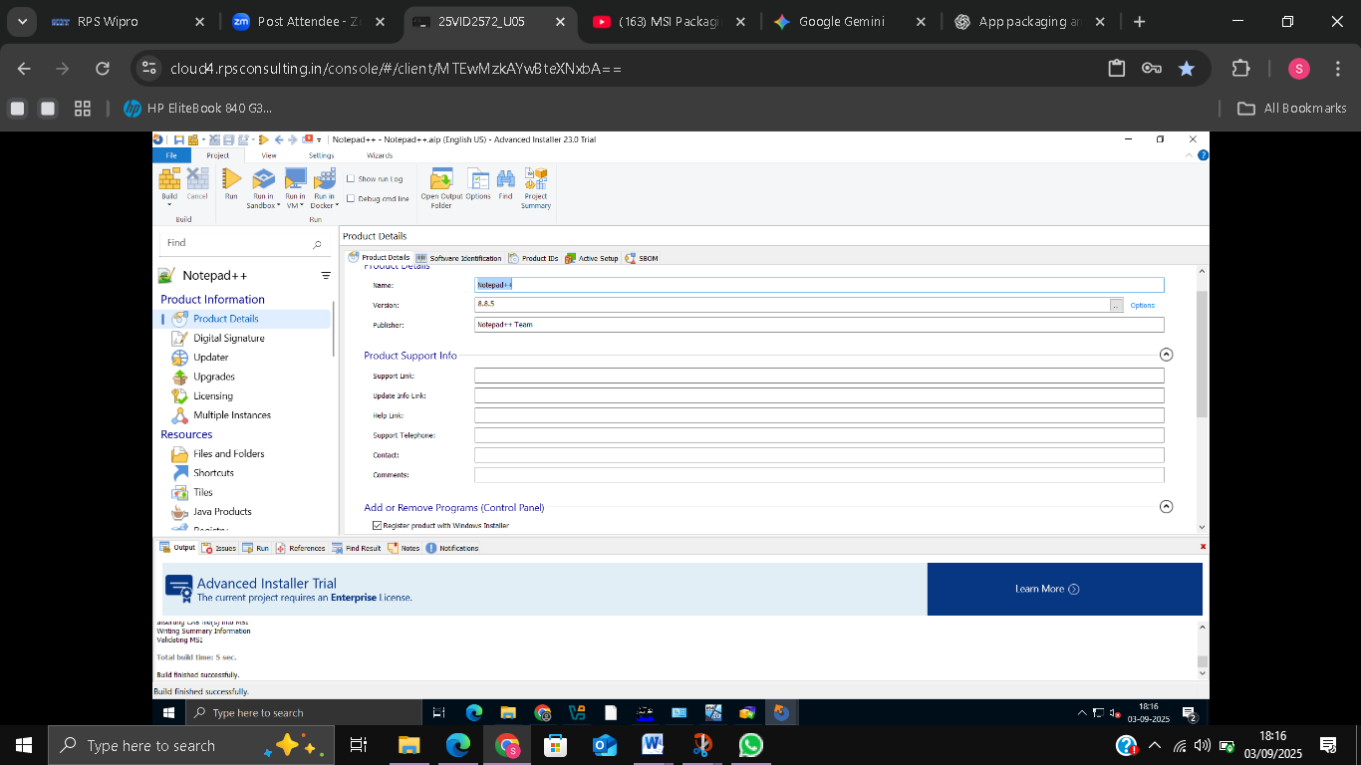
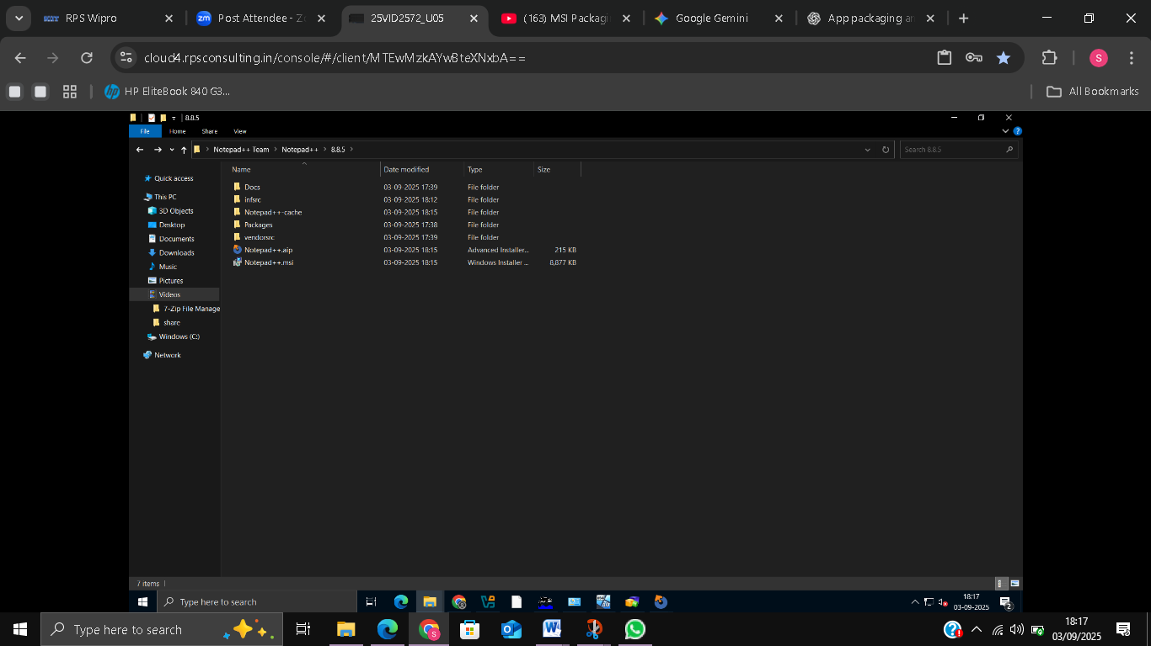

Slide 29
CREATING MSIX FILE
Created MSIX File from MSI Using Advanced Installer
Selected Notepad++ MSI package as input.
Converted MSI → MSIX package
Installed certificate from certmgr.msc
Exported the certificate

Slide 30
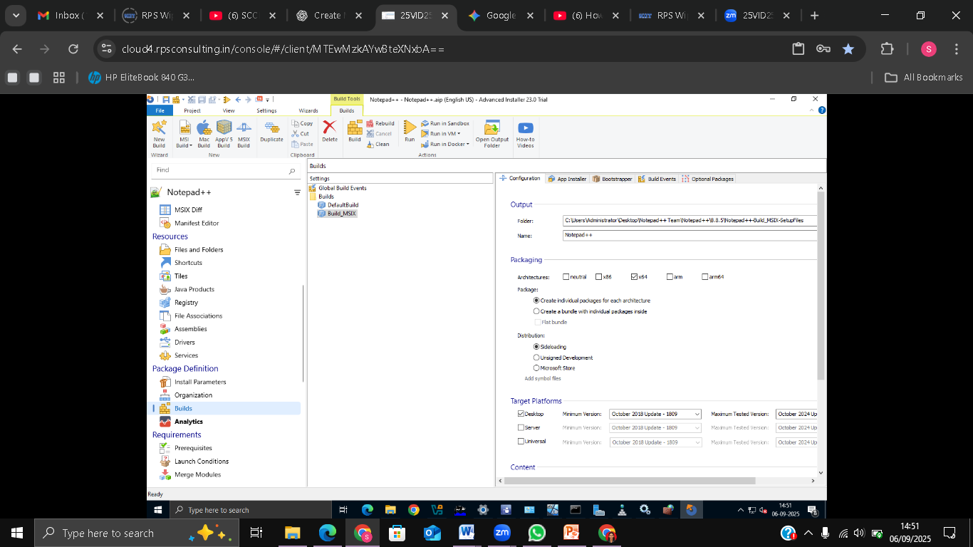
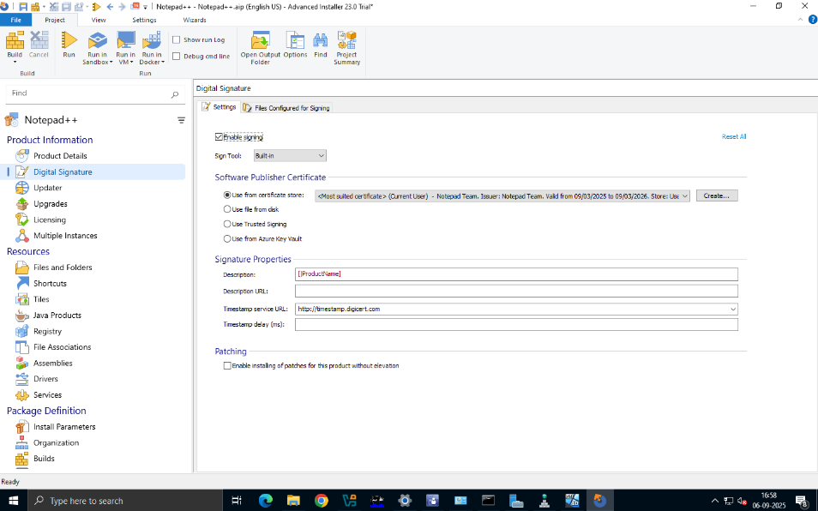
Creating and Signing the MSIX Package

Slide 31
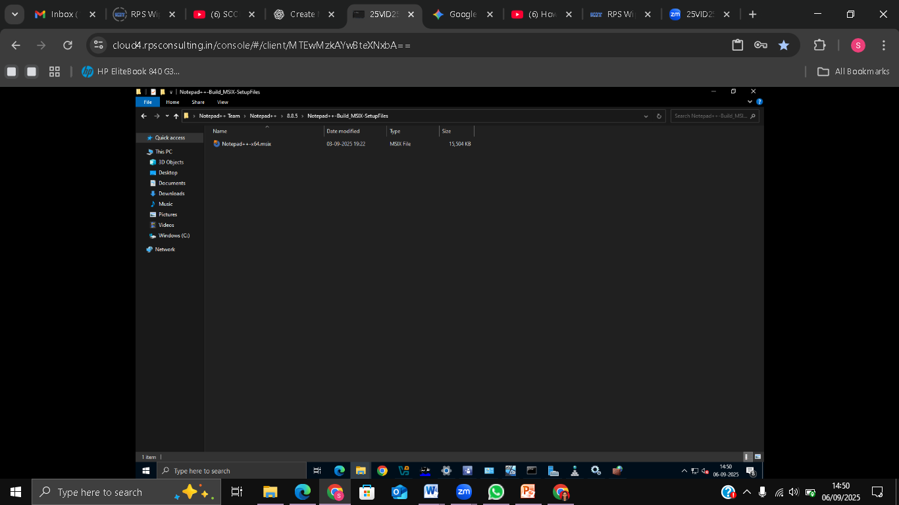
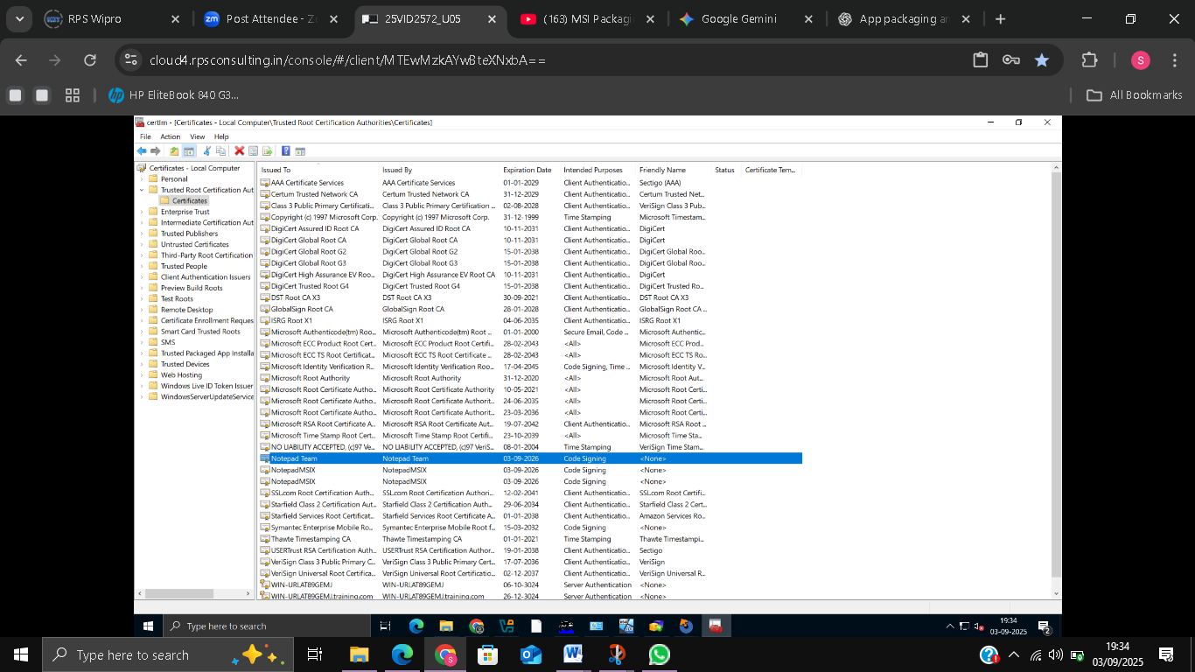
MSIX Package Created and Certificate Verification

Slide 32
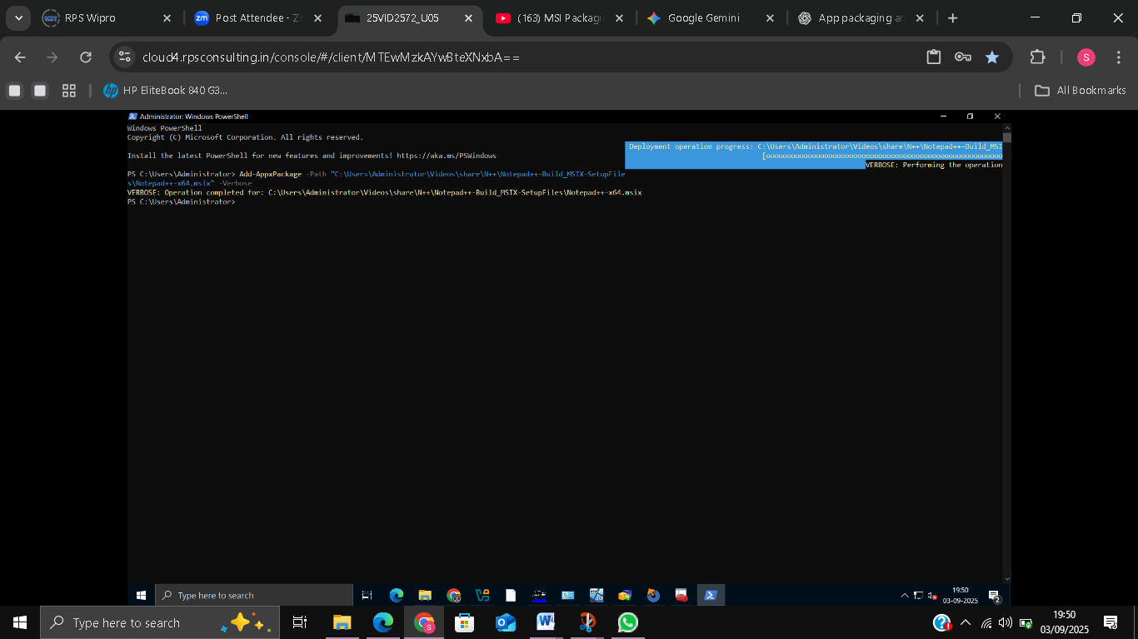
INSTALLATION VIA POWERSHELL
Installed MSIX using Powershell.
Verified installation successfully.

Slide 33
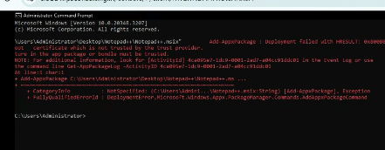
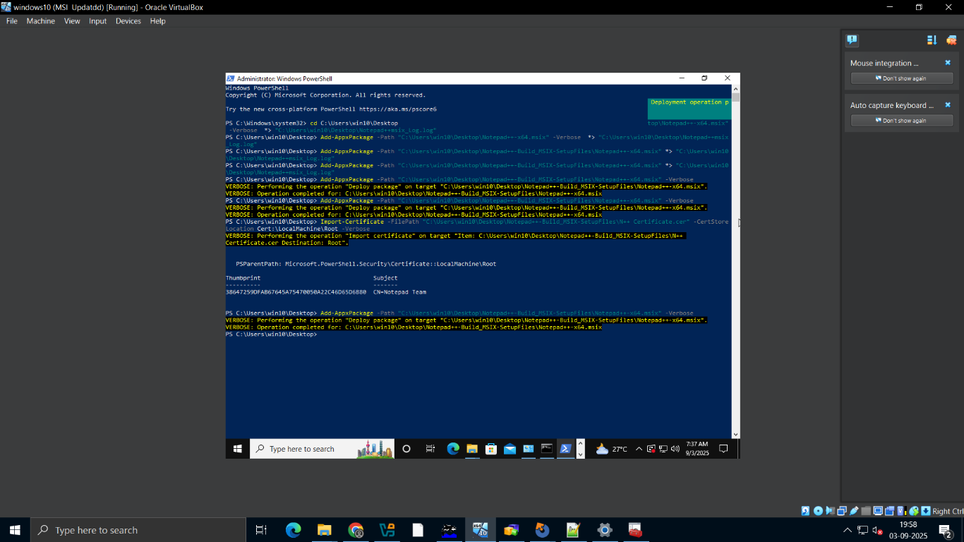
Resolving the Certificate Trust Error

Slide 34
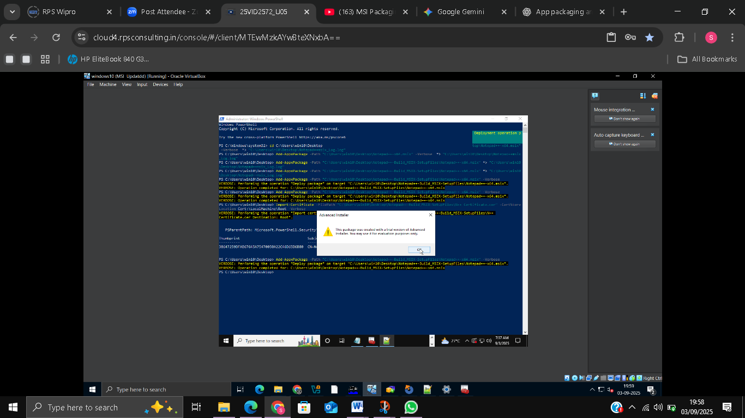
Installing the MSIX Package using Command Prompt

Slide 35
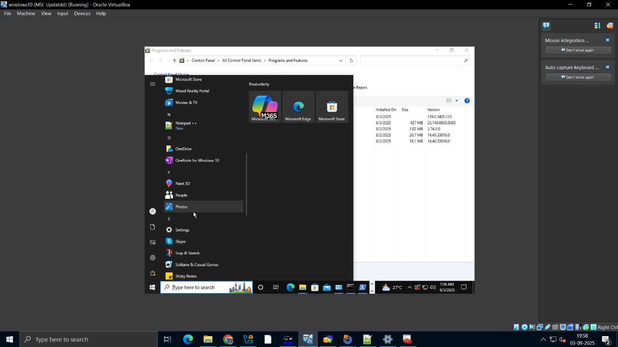
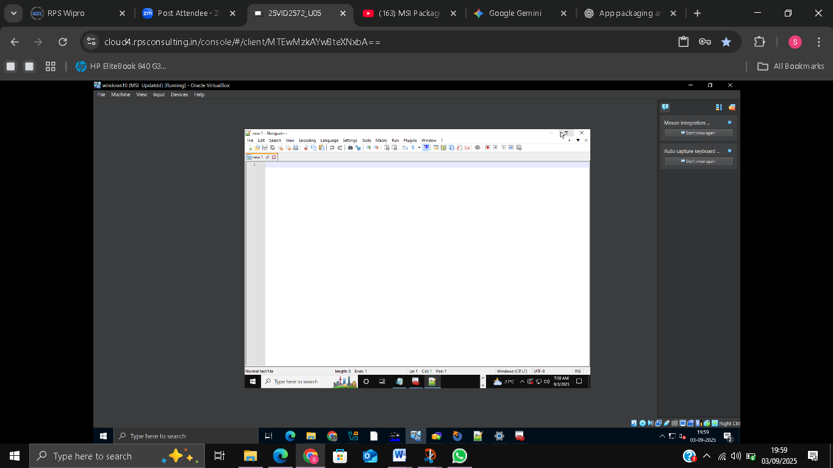

Slide 36
INSTALLATION & UNINSTALLATION VIA PSADT
Added MSIX files to PSADT deployment folder.
Wrote install/uninstall scripts with descriptive comments.
Automated deployment worked correctly.
COMMANDS:
Install: .\Invoke-AppDeployToolkit.exe -DeploymentType Install
Uninstall: .\Invoke-AppDeployToolkit.exe-DeploymentType Uninstall

Slide 37
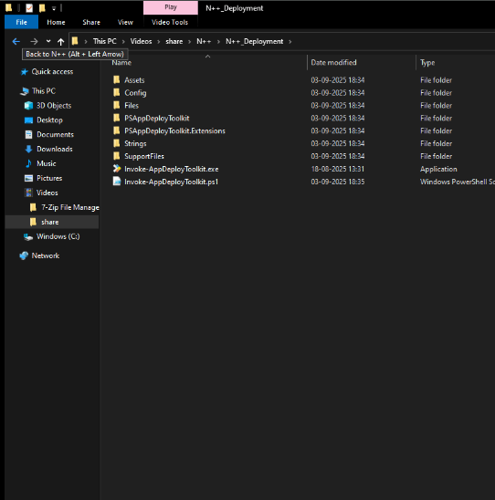

Notepadd ++PSADT deployment folder

Slide 38



Slide 39


PSADT script executed – application installed successfully

Slide 40


PSADT script executed – application uninstalled successfully

Slide 41



Slide 42
CONCLUSION
Strengthened understanding of software installation
Gained hands-on experience in application packaging
Learned how to troubleshoot installation issues effectively
Gained practical exposure to end-to-end Packaging workflow

